Slide 1


University of Padua
Computer-ICT Engineering
WEB APPLICATION
REMYTUTOR
Group members:
Dalla Mutta Marco
Dell’Anna Marco
Jin Xianwen
Memen Hamzah Obaid Salihi
Semencenco Victor
Ahmad Bashir Usman
10-06-2020

Slide 2
University of Padua
Computer-ICT Engineering
Web Application
Profile Page
10-06-2020
Presentation Remytutor

Slide 3
University of Padua
Computer-ICT Engineering
Web Application
Password
  Pattern="(?=.*\d)(?=.*[a-z])(?=.*[A-Z]).{6,}" , which means that the password must contain at least 6 characters, including UPPER/lowercase and numbers;
  Cryptographic hash function SHA-256;
  Saved into database;
  Could be updated from personal profile page.
10-06-2020
Presentation Remytutor

Slide 4
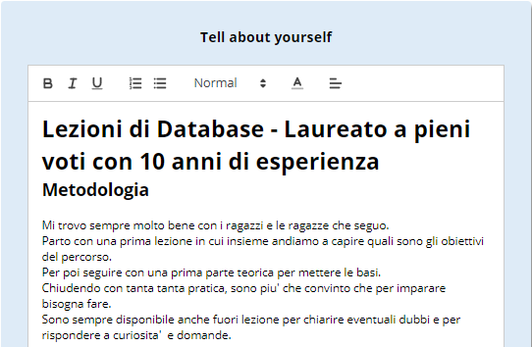
University of Padua
Computer-ICT Engineering
Web Application
Quill.js Editor
  Powerful Rich Text Editor;
  Its content is saved into database with html format.
10-06-2020
Presentation Remytutor

Slide 5
University of Padua
Computer-ICT Engineering
Web Application
REST
Our web application is mainly 1.0 and the rest is implemented only for illustration purpose;
For simplicity, we implemented only readPerson() in PersonRestResource, but other methods such as updatePerson() could be developed easily by using updatePersonDAO.
10-06-2020
Presentation Remytutor

Slide 6
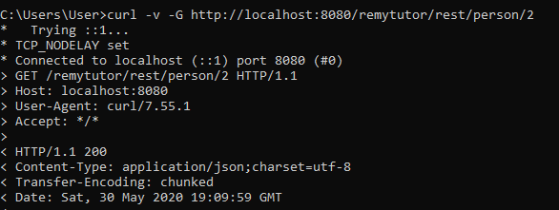
University of Padua
Computer-ICT Engineering
Web Application
REST
To read a person data, the request URI is: /person/{idUser}
10-06-2020
Presentation Remytutor

Slide 7
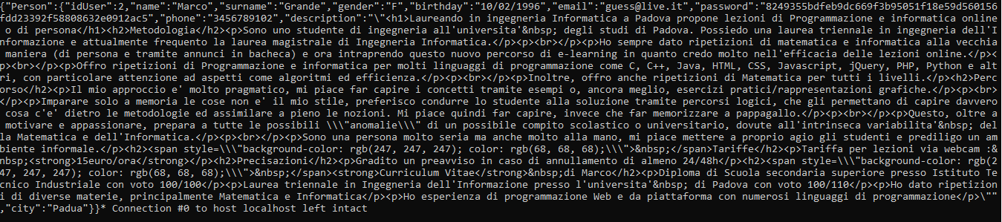
University of Padua
Computer-ICT Engineering
Web Application
REST
The result of the request.
10-06-2020
Presentation Remytutor

Slide 8
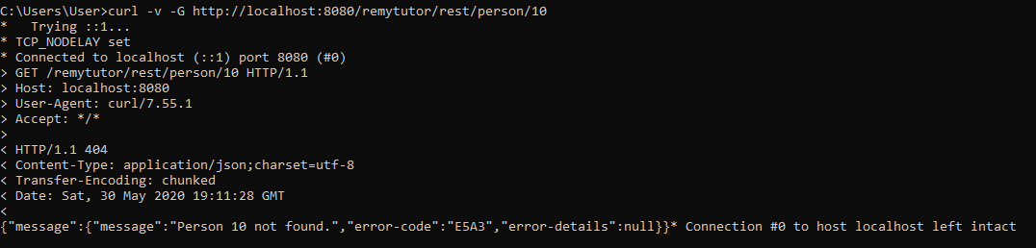
University of Padua
Computer-ICT Engineering
Web Application
REST
Querying a person that does not exist
10-06-2020
Presentation Remytutor

